Slide 1
College Admission Agent
IBM HACKATHON PROJECT
Presented By:
Student name : Bolla Revanth
College Name & Department : NNRG ( CSE)

Slide 2
OUTLINE
Problem Statement
Technology used
Wow factor
End users
Result
Conclusion
Git-hub Link
Future scope
IBM Certifications

Slide 3
Problem Statement
Students and parents often face confusion during the college admission process due to scattered information about courses, eligibility, fee structures, deadlines, and application procedures. Manually searching websites or contacting support staff is time-consuming and often leads to incomplete or outdated information.
Proposed Solution: An AI-powered College Admission Agent that uses Natural Language Processing (NLP) and Retrieval-Augmented Generation (RAG) to answer student queries instantly. It retrieves relevant information from uploaded documents and responds to questions about courses, eligibility, fees, and deadlines, making the admission process faster, easier, and more transparent.

Slide 4
Technology used
IBM cloud lite services
Natural Language Processing (NLP)
Retrieval Augmented Generation (RAG)
IBM Granite model

Slide 5
IBM cloud services used
IBM Cloud Watsonx AI Studio
IBM Cloud Watsonx AI runtime
IBM Cloud Agent Lab
IBM Granite foundation model

Slide 6
Wow factors
- Instant answers to student queries
- Accurate information from real documents
- Reduces manual workload for staff
- Enhances accessibility and transparency
- Easy to deploy with IBM Watsonx interface

Slide 7
End users
- Students
- Parents
- College Admission Teams
- School Counselors
- Educational Consultants

Slide 8
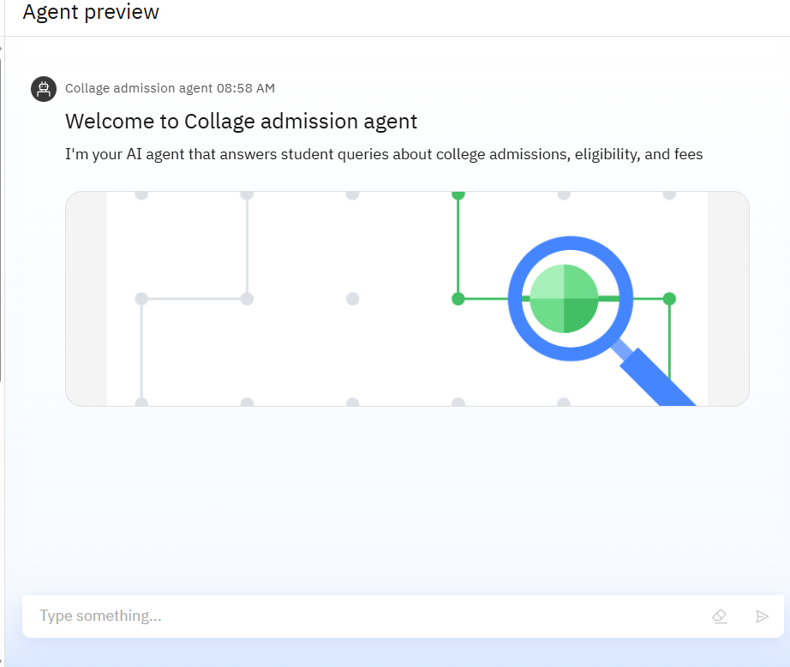
Results

Slide 9
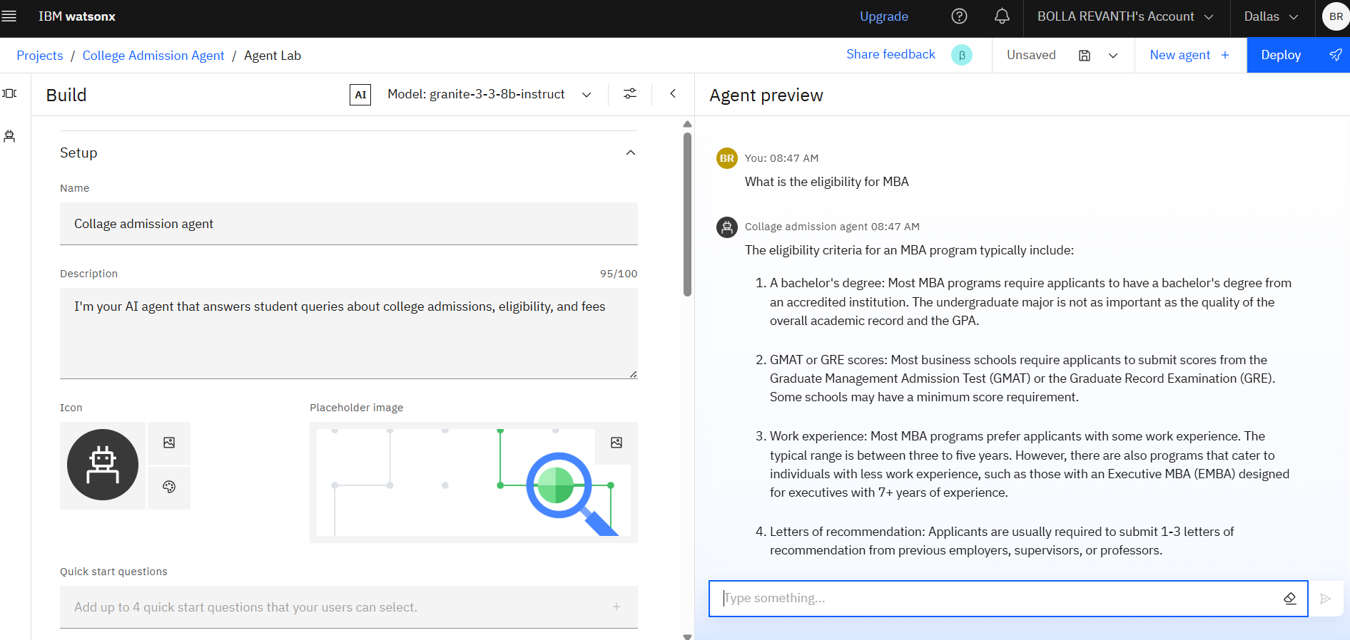
Results

Slide 10
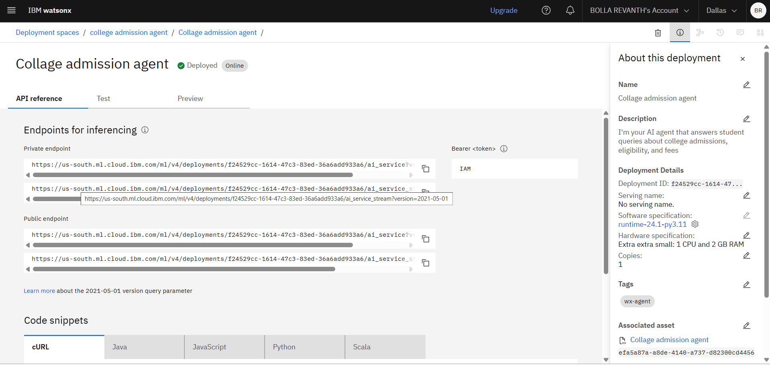
Results

Slide 11
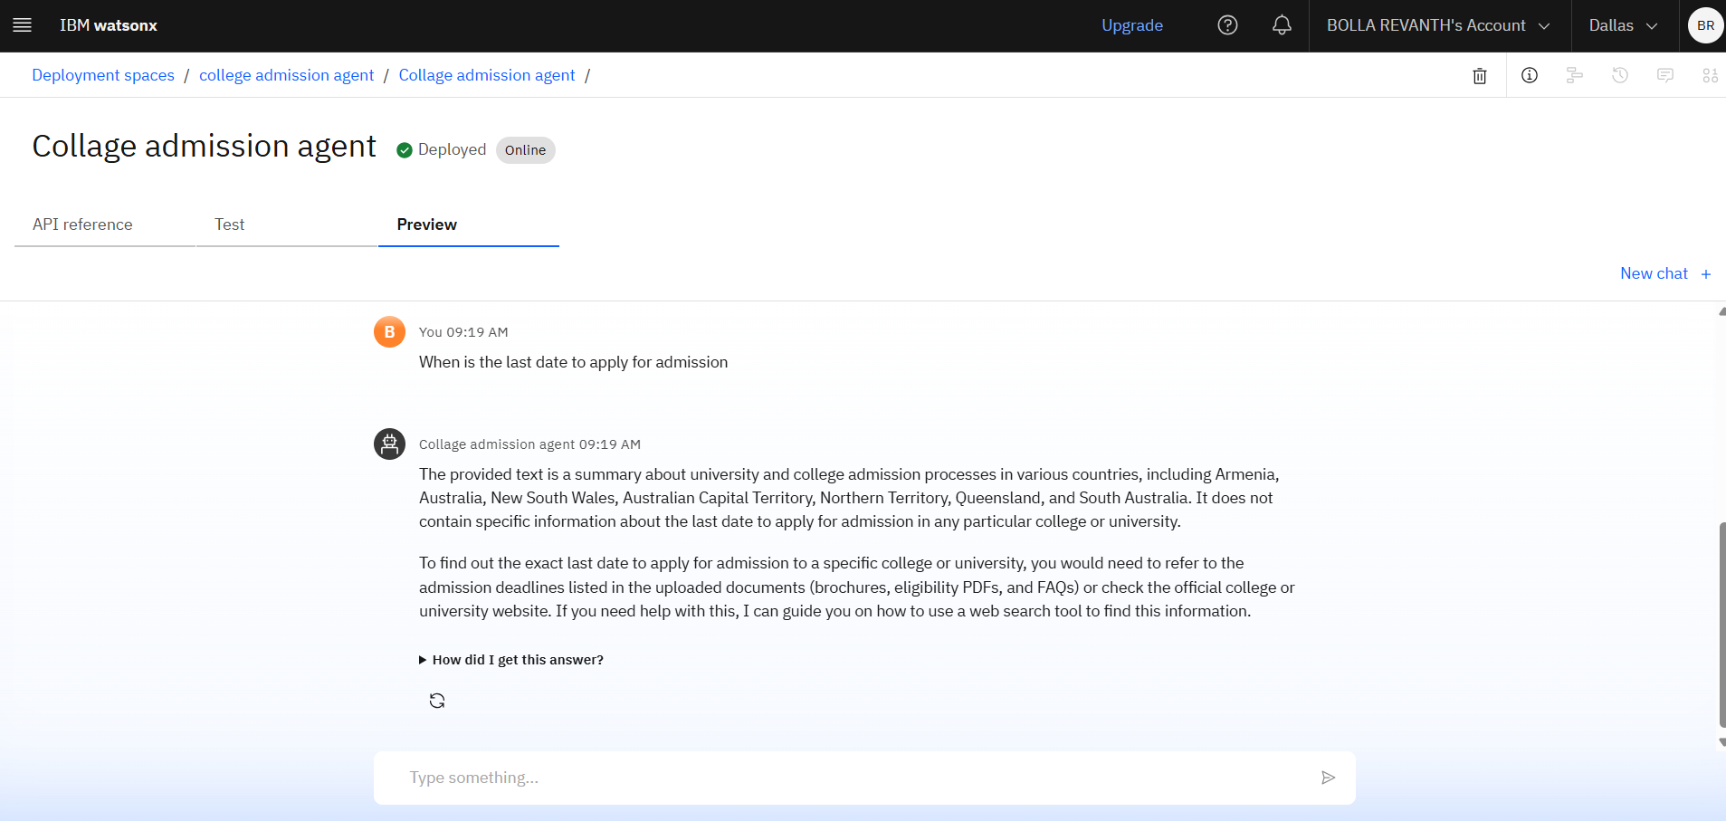
Results
Deployed AI Agent

Slide 12
Conclusion
The AI-powered agent provides instant answers to admission-related questions using NLP and RAG.
It reduces manual workload and improves transparency for both students and staff.
The solution makes the admission process faster, easier, and more accessible through IBM Cloud Lite.

Slide 13
GitHub Link
https://github.com/Revanth194/college-admission-agent/tree/main

Slide 14
- Add voice and regional language support
- Integrate with real-time admission portals
- Include chatbot in college mobile apps
- Use analytics to track popular questions
Future scope

Slide 15
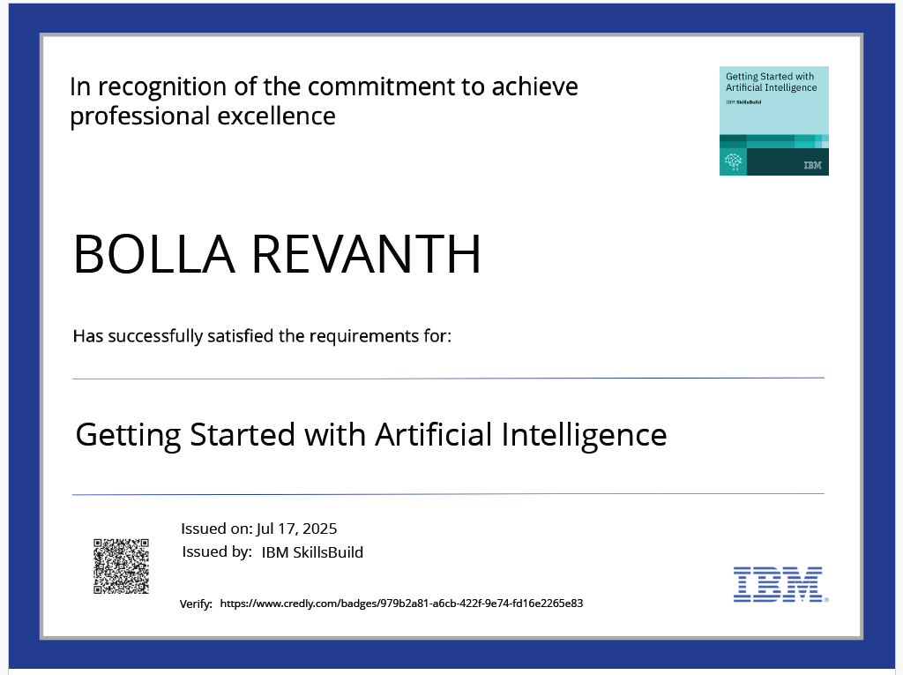
IBM Certifications
Screenshot/ credly certificate( getting started with AI)

Slide 16
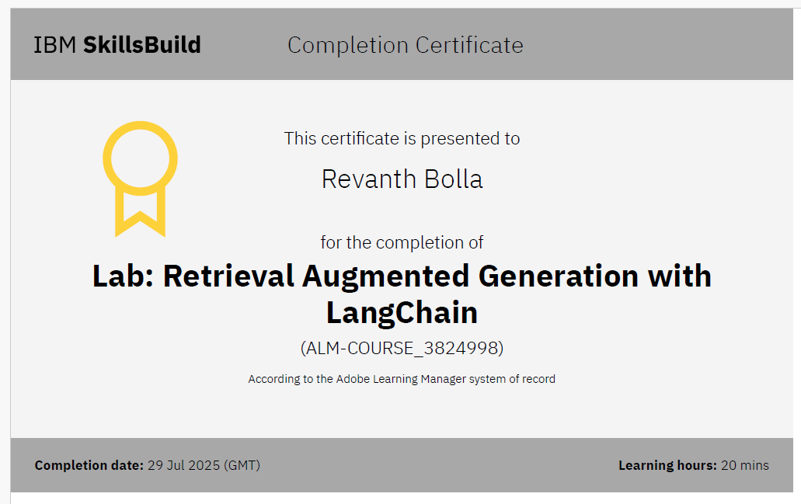
Attach your RAG LAB certificate here

Slide 17
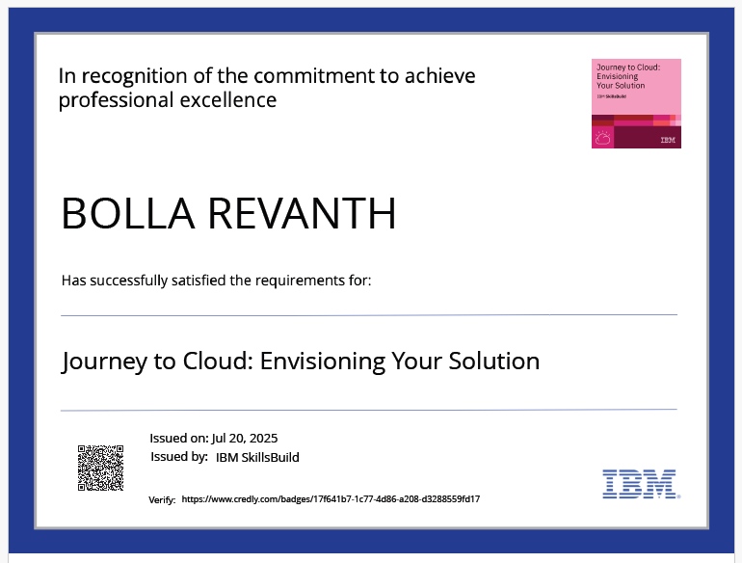
Attach your RAG LAB certificate here

Slide 18
THANK YOU

